Slide 1
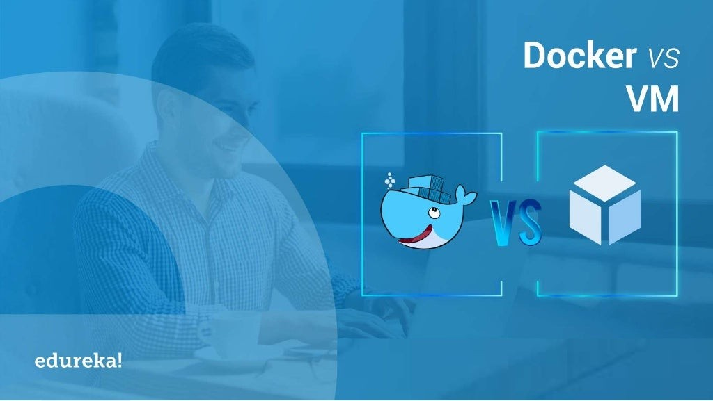

Slide 2
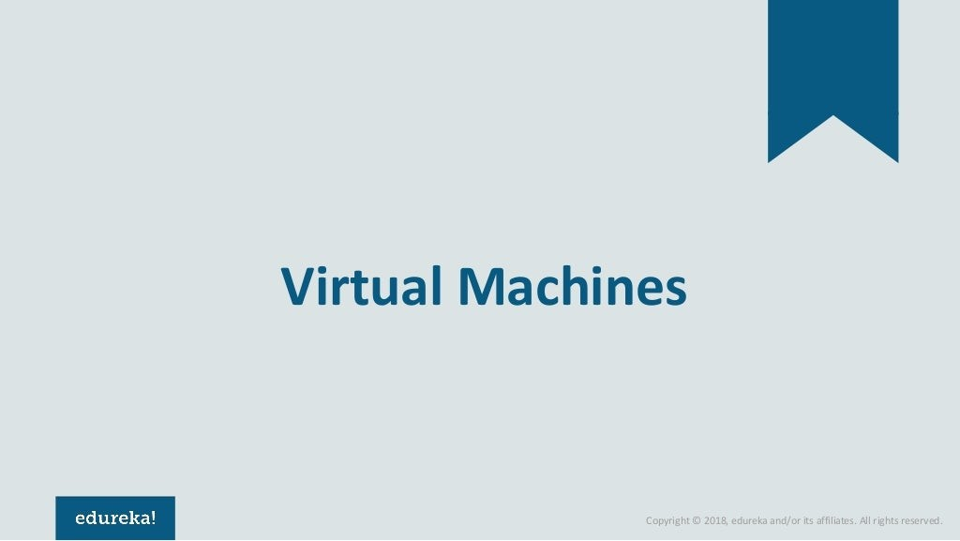

Slide 3
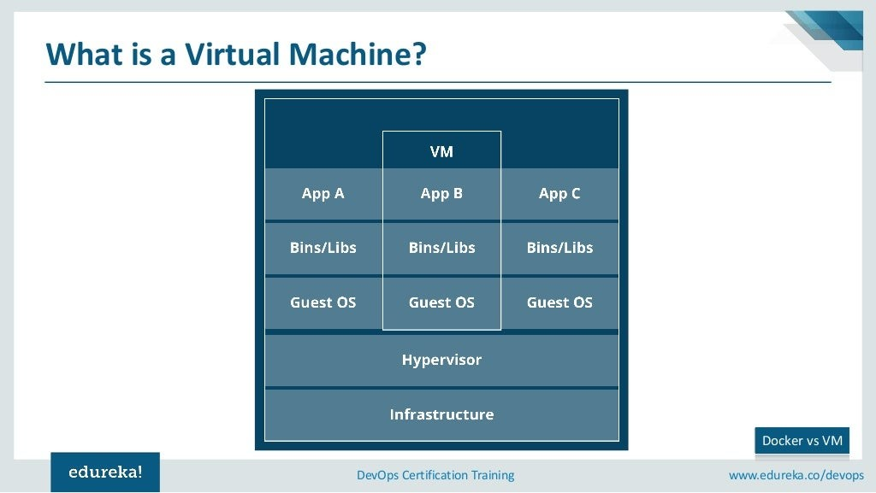

Slide 4
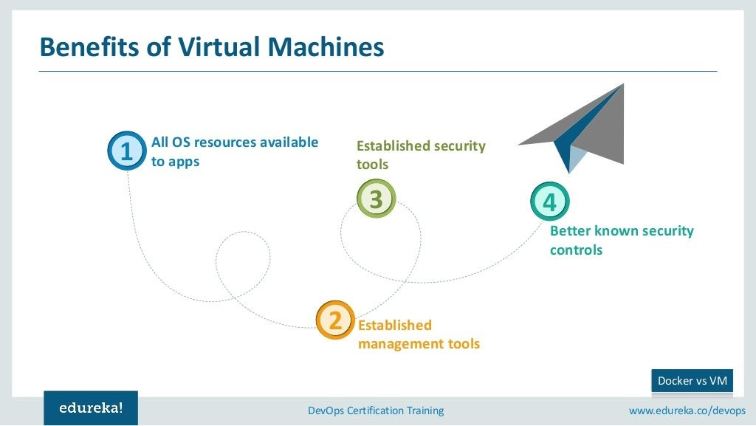

Slide 5
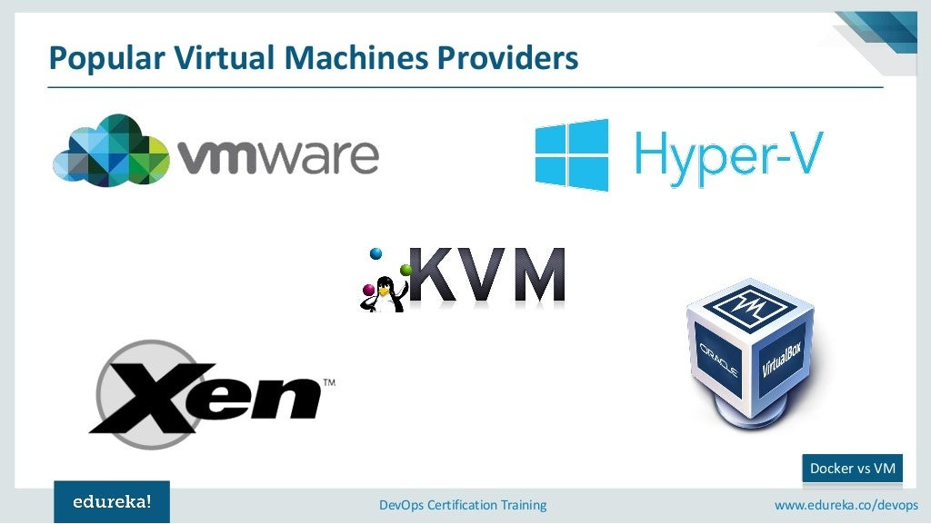

Slide 6
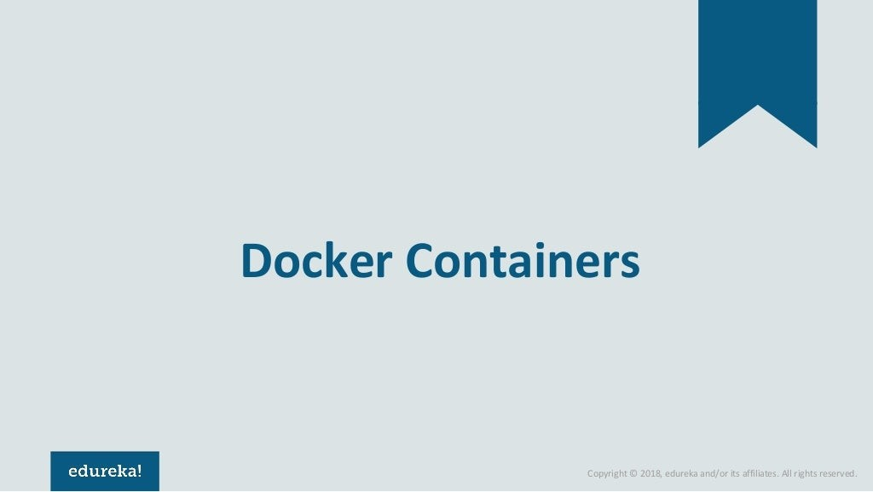

Slide 7
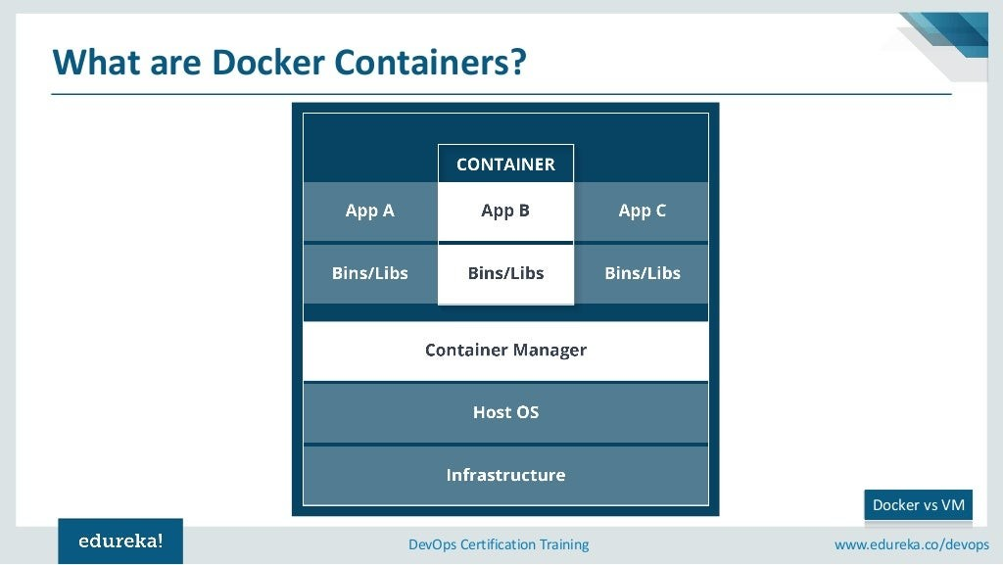

Slide 8
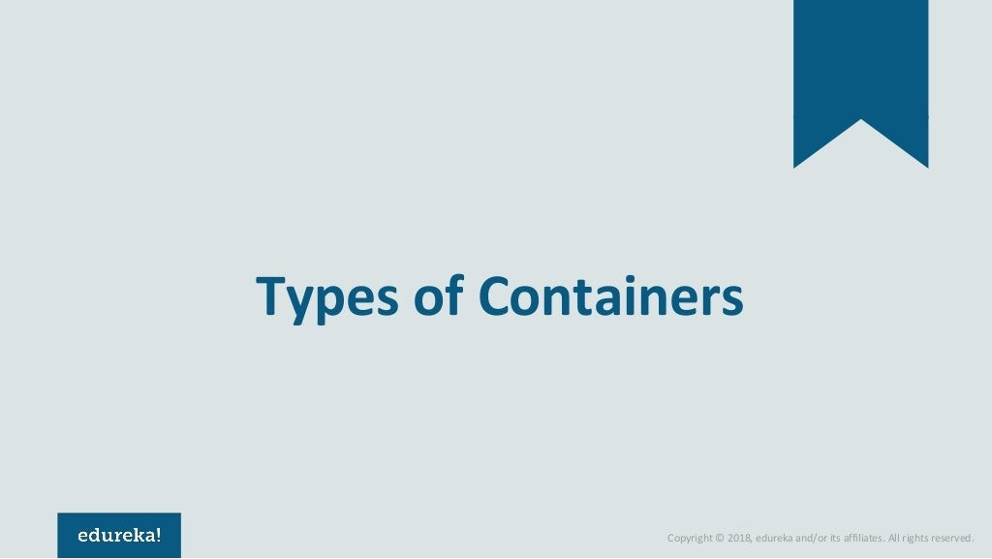

Slide 9
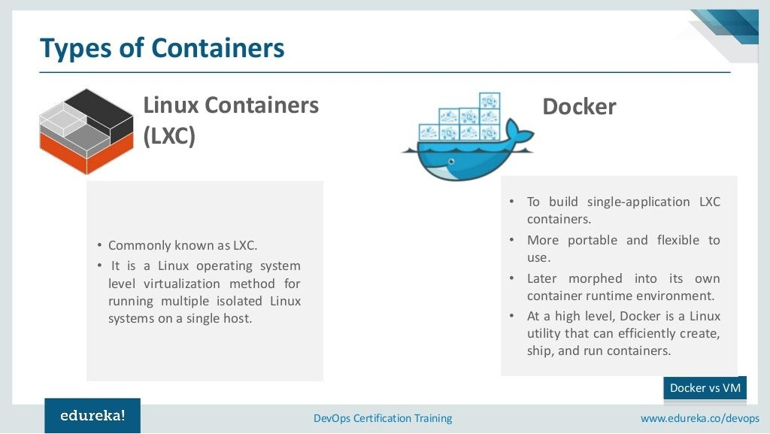

Slide 10
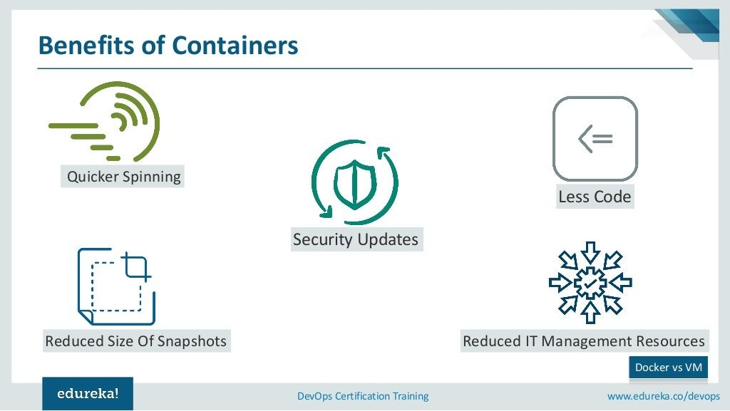

Slide 11
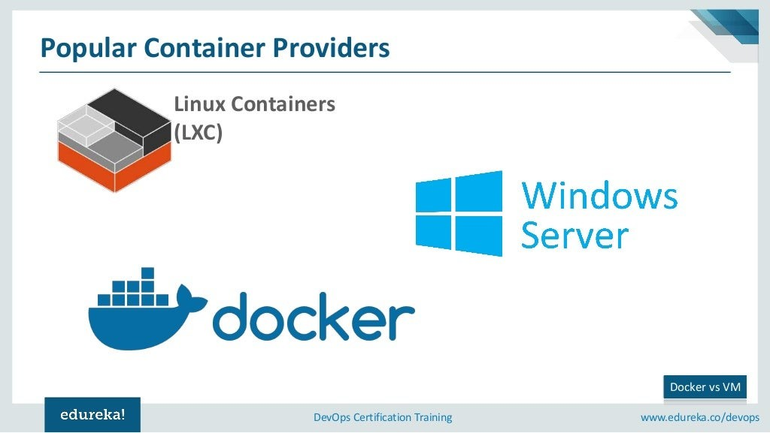

Slide 12


Slide 13
Virtual Machine | Container
VM is piece of software that allows you to install other software inside of it so you basically control it virtually as opposed to installing the software directly on the computer | While a container is a software that allows different functionalities of an application independently.
Applications running on VM system can run different OS | While applications running in a container environment share a single OS.
VM virtualizes the computer system. | While containers virtualize the operating system only.
VM size is very large | While the size of container is very light; i.e. a few megabytes
VM takes minutes to run, due to large size. | While containers take a few seconds to run.
VM uses a lot of system memory. | While containers require very less memory
VM is more secure. | While containers are less secure.
VM’s are useful when we require all of OS resources to run various applications. | While containers are useful when we are required to maximise the running applications using minimal servers.

Slide 14
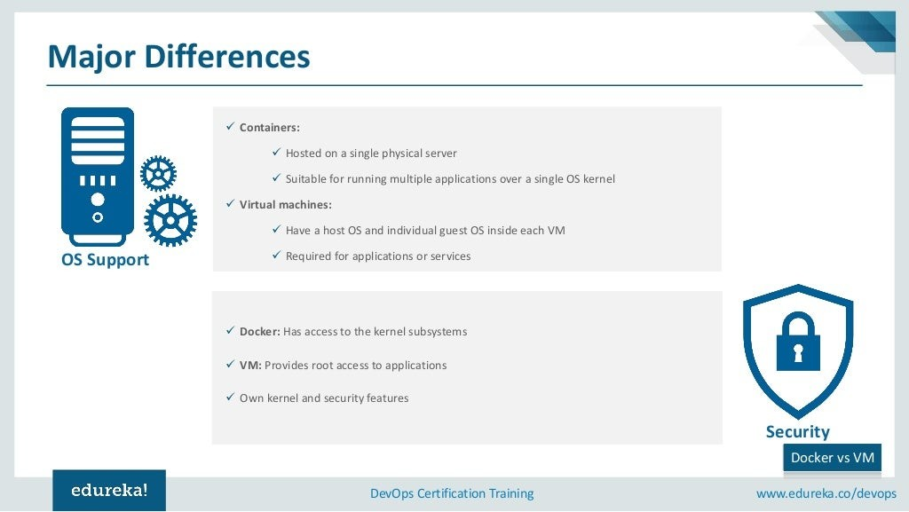

Slide 15
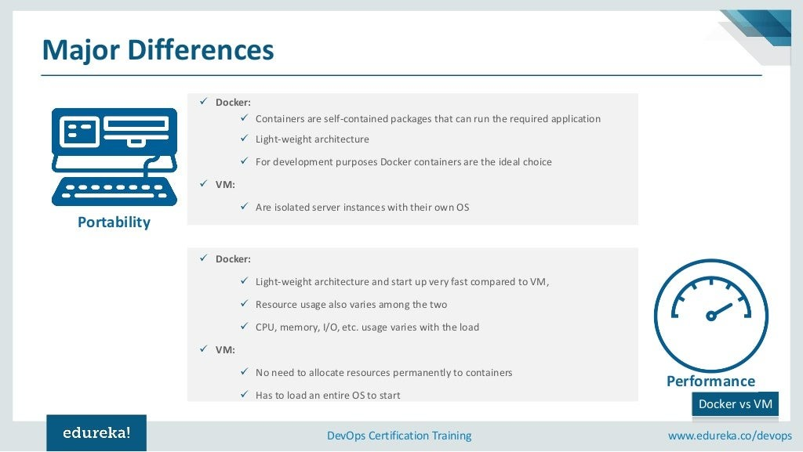

Slide 16
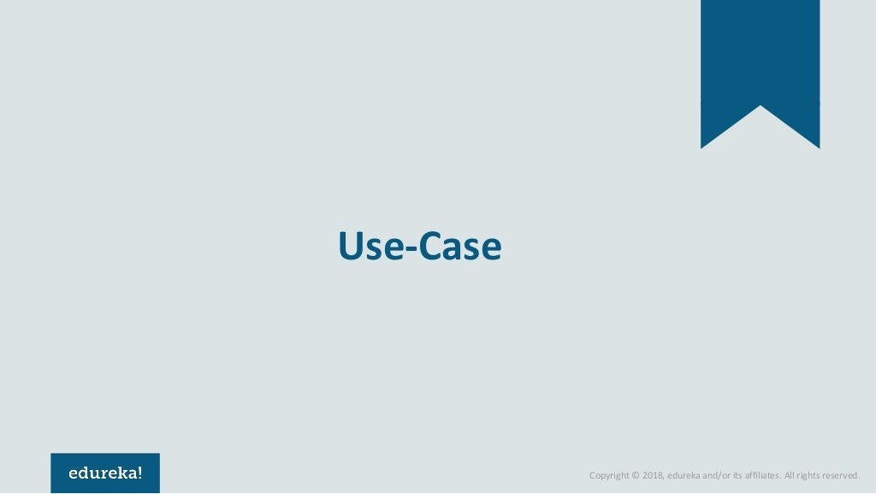

Slide 17
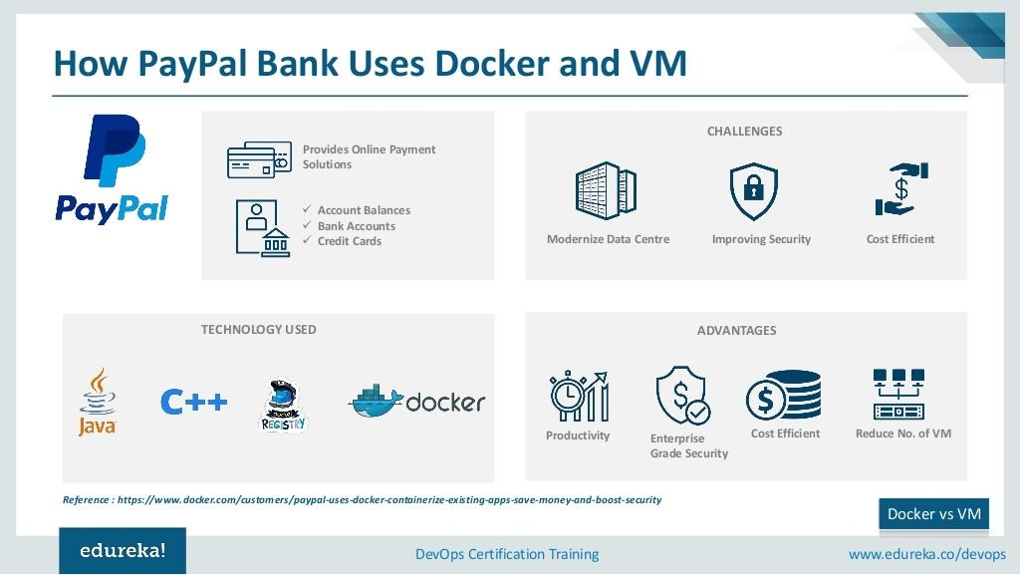

Slide 18
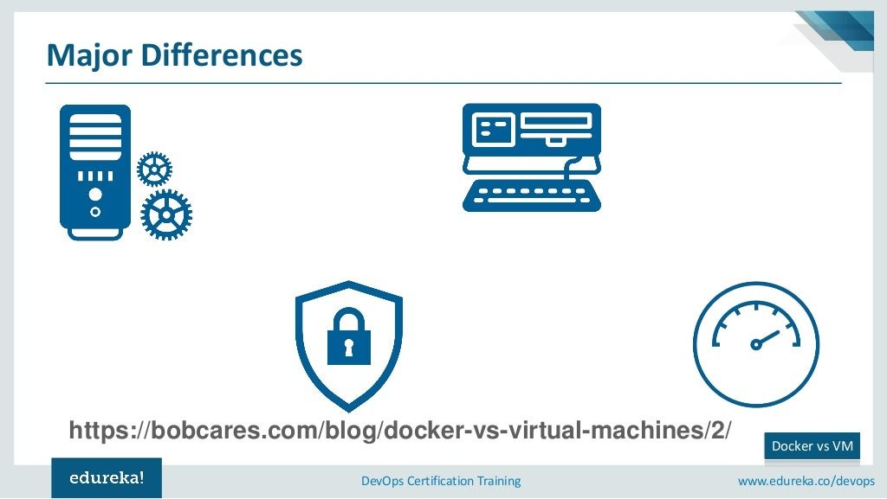

Slide 19
